Slide 1


How to present like a professional
Dr Rabia Khan

Slide 2


Think of your own experiences ……
and
The best

Slide 3
Presentation Tips
List the 7 tips mentioned in the following video:
https://www.youtube.com/watch?v=MnIPpUiTcRc

Slide 4

Structure of today’s session
The 4 Steps to presentation success!
Preparation
Planning
Practice
Delivery
By the end of the session you should be able to name the steps to take to prepare and deliver a successful presentation.

Slide 5
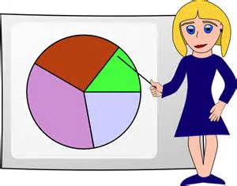
When might you be asked for a presentation? ……
Interview and/or Assessment centre:
Preparation time can vary
Course presentation
Work presentation
Viva (academic presentation)

Slide 6

Exercise: on the spot presentation
You are in a group interview with several others
Each person has to introduce themselves in no more than a minute
What are you going to say?
(e.g. from Aldi)
https://www2.mmu.ac.uk/research/research-study/events/3mt/
Notes:
If too big a group – could go round and ask them to introduce themselves and one thing they like doing…… just to get them speaking.

Slide 7

Aspects you need to consider
Audience
Timings
Subject
Content & visuals
Delivery

Slide 8
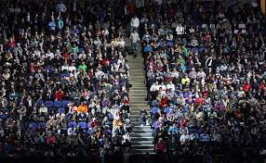
Preparation & Planning – the audience
Who is the audience?
What are their expectations?
Involve the audience – ask questions of them
Never underestimate the audience’s intelligence
What is their level of knowledge of the subject?
mmu.ac.uk/careers
Notes:
Audience
talk is different to written - listeners have one chance to hear you talk and cannot reread when they get confused
KISS = keep it simple stupid better to be too basic than too difficult

Slide 9

Preparation & Planning – timings
How long have you got?
How many slides will you need?
Practise out loud – ideally, with an audience – get feedback and take it well!
Do not go over your time allocation
mmu.ac.uk/careers
Notes:
Most prepare too much material – space = more time for questions
it is very difficult to cut a power point presentation at the event itself
Number of themes:
5 minute presentation – 3 main themes
10 minutes – 4 main themes
15 minutes – 5 main themes
Use no more than one slide per minute
Ask for feedback:
Q. Were you talking too fast or too slowly?
Q. Were your visual aids clear?
Q. Did you move logically from one point
to another?
Q. Were you interesting or uninspiring?
Take criticism well and make changes

Slide 10


Preparation & Planning – your visuals
Find out what technology you’re allowed
Font size & consistency
Neat, accurate & numbered
Take a hard copy of your presentation
Handouts? Alternatives to Powerpoint?
Rookie presenting mistakes
Notes:
Rookie presenting mistakes = example of a prezi if they’ve not seen one before/not v familiar with it – scroll down to half way down the page and press enter. Could show them the whole thing or just one or two of the bubbles.
Prepare on paper first before putting it onto PowerPoint. The following guide will help
5 minutes talk time = 750 words, 10 minutes = 1.500 words, 15 minutes = 2,250 words
Font size
smallest text should be 32 font
space between lines
easy to read colour schemes
use colour to highlight key words
if it will not fit scrap or start a new slide
Consistency in style
Pictures,
Confucius says a picture is worth a thousand words
pictures are great for breaking up sections
charts, graphs and diagrams to illustrate results
take the focus off you
will be remembered longer than text
one picture = a thousand words
good for abstract concepts
if it’s a serious debate – stick to plain lettering and keep colours calming
if its based on a hobby or music be more relaxed and inventive
less is more – not too many pictures or colours on each slide it can distract the audience

Slide 11

Preparation & planning - subject
Research your subject as thoroughly as possible
Don’t overload with information – 3 key points?
Don’t bluff or blag it
Any fresh ideas?
Try and anticipate likely questions
Notes:
Does knowing the words to a song make you a great singer? –just because you have a lot of knowledge about a topic doesn't automatically mean you are capable of communicating that to others

Slide 12
Project video viva
3 questions
5 minutes

Slide 13

Planning & preparation - structure
Plan the structure of your talk:
A strong beginning
A solid & interesting middle
A clear conclusion
Notes:
Tell them what you are going to say
Say it
Tell them what you have said

Slide 14

A strong beginning
Title – can you make it catchy?
If appropriate – event, date, your name and position
Catch the attention - relevant anecdote, question, current news story or contradictory statement?
KEEP IT SHORT AND SNAPPY!
mmu.ac.uk/careers
Notes:
check everyone can see
Effective starts - refer to a current news event – gives relevance and seems spontaneous
a striking stat or poignant question
Watch your time – introductions can easily eat into time

Slide 15
The middle section/content
Outline your key themes/argument
Deliver a jaw-dropping moment!
Teach your audience something new
Focus on getting 2/3 main points across
Be logical & accurate – no typos!
Be creative – think interest and variety
Notes:
Teach your audience something new. The human brain loves novelty. An unfamiliar, unusual, or unexpected element in a presentation jolts the audience out of their preconceived notions, and quickly gives them a new way of looking at the world. Robert Ballard is an explorer who discovered Titanic in 1985. He told me, “Your mission in any presentation is to inform, educate, and inspire. You can only inspire when you give people a new way of looking at the world in which they live.”
Deliver jaw-dropping moments. The jaw-dropping moment—scientists call it an ‘emotionally competent stimulus’— is anything in a presentation that elicits a strong emotional response such as joy, fear, shock, or surprise. It grabs the listener’s attention and is remembered long after the presentation is over. In this column on how Bill Gates radically transformed his public-speaking skills, I demonstrate how Gates learned to incorporate a jaw-dropping moment into many of his public presentations, including his now famous TED talks.

Slide 16
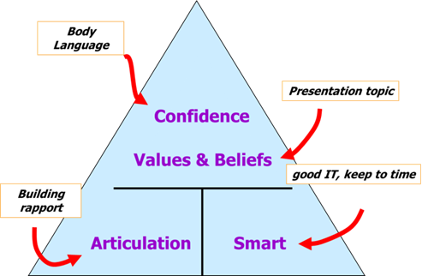
Visuals - be creative
Use quotes
“By failing to prepare, you are preparing to fail.” ― Benjamin Franklin
You could use video or sound clips:
Video clip
You could also use images, graphs, diagrams, music, props or case studies
Above all though, use narrative - people respond to stories so paint a picture in their mind
Notes:
Video clip = good and bad presentation tips
Interestingly the use of visual aids generally heightens retention of the spoken word - it is said by some up to 70%
materials, media, exercises, gather spice, case-studies, statistics, props, quotations, analogies, participation, syndicates, anticipate questions, know your knowledge-base and reference points
decide your prompt system - cue cards, notes, whatever suits you best.

Slide 17
Wrapping up
Briefly summarise key points - tell them what you have just told them
Ask if anyone has questions
Important to have a clear ending
“Take Home Message”
Notes:
Leave with a parting shot
e.g. if talking about music suggest songs or albums you have enjoyed,
e.g. sport – suggest clubs where audience can try it out or watch it
Last slide should include any contact details if appropriate

Slide 18
Some Assessment Centre examples
10 min presentation: two topics to choose from: "Why would you be a good choice for our grad scheme?" and "Describe an interesting hobby". (Cable and Wireless)
Had to prepare a 15 minute presentation in advance on "How to create business value through IT" (AXA)
Why IBM should employ you?
20 min to prepare a 5 min presentation on a group project you have worked on at some point, preferably where you had a choice of topic. (Atos Origin)
Notes:
Cable & Wireless (one hour to prepare)
AXA in advance
IBM in advance
Atos (20 mins notice)

Slide 19
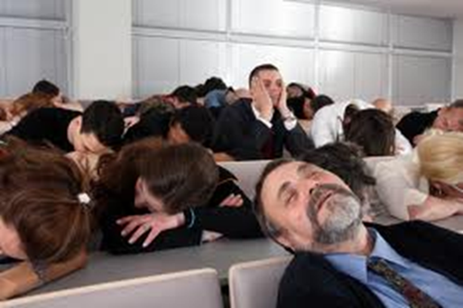
Delivery - presence
Energy!!!
Less energy!
As always, first impressions count
Voice
Body language
- smile
- make eye contact
- mannerisms
Rapport
mmu.ac.uk/careers
Notes:
Clip 1 = Steve Ballmer – ex CEO of Microsoft.
Clip 2 – teacher from Ferris Bueller’s day off -
Voice – speak slowly and clearly, loudly enough so all can hear but don’t shout
Avoid speaking in a monotone voice – very boring and tiring to listen to
Tone – be enthusiastic not pedantic
Pace – speak at normal pace, too slow and the audience will nod off, too fast and they don’t understand a word
Always stand – it gives confidence and helps with voice projection
Body Language
stand tall, take a deep breath and look as it you are going to enjoy being there
Talk to your audience not to your notes
Keep hands out of pocket and away from your face
Be aware of your gestures – if you conduct an orchestra while you speak the audience will be distracted
Space - Use the space around you – but avoid pacing up and down
It can add interest if come to the front to deliver a telling point
avoid hiding behind the lectern
Eye contact
make eye contact in a friendly way – don’t glare
people respond better if they think you are talking to them
in a small room try to make contact with each person in the audience
in a large room make eye contact with different groups
Rapport
a presentation is a performance
Script - do not learn the speech by heart – you need to engage
it makes you sound wooden and will it distance you from your audience.
(links to nerves – OK to script first few sentences)
Use flash cards - put key words, phrases and facts – use slide headings
make sure writing is large enough to read at a glance
keep the cards in sequence

Slide 20

Delivery - technique
Don’t start with an apology
Never embarrass your audience!
Avoid jargon/slang/colloquialisms
Humour – be careful!
mmu.ac.uk/careers
Notes:
You have 4 - 7 seconds in which to make a positive impact and good opening impression, so make sure you have a good, strong, solid introduction, and rehearse it to death. Dress smartly
Jargon – not everyone is familiar with acronyms – use full phrase
Avoid slang terms
Props are good e.g. something you use for a particular sport, samples of music or medals or trophys you’ve earned
pass them around the audience
But DO NOT play with them as it is distracting
Humour – if you are not good at telling jokes – don’t try but if you are they can make a presentation memorable
Jokes can back fire so should be used with caution
They are not hiring you to be a stand up comedian
The way you say something is equally if not more important than what you say

Slide 21

Handling nerves
Script first few sentences
Check any words you are unsure of and memorise
Breathe deeply
Practice!
Notes:
Remember most people are nervous - it is perfectly natural
drink water & eat breakfast and or lunch – if hungry will lose concentration
Tips - talk to the audience as if they are a group of friends
smile and make eye contact
Breathing
when you are nervous tend to take quick shallow breaths – makes your voice sound weak
breath deeply and slowly– helps reduce anxiety
Breathing exercise – learn to breathe slowly and deeply
concentrate on filling tummy with air
breath out slowly getting rid of as much air as you can
each time you take a breath in, hold it in tummy and then breathe out slowly getting rid of more air than you breathed in – expands lungs, gives more oxygen

Slide 22
In conclusion
Prepare & practice!
Use the Careers & Employability Service guide to presentations
Look online for inspiration – e.g. TED talks
If you require further support and advice on planning a specific presentation book an appointment

